Slide 1
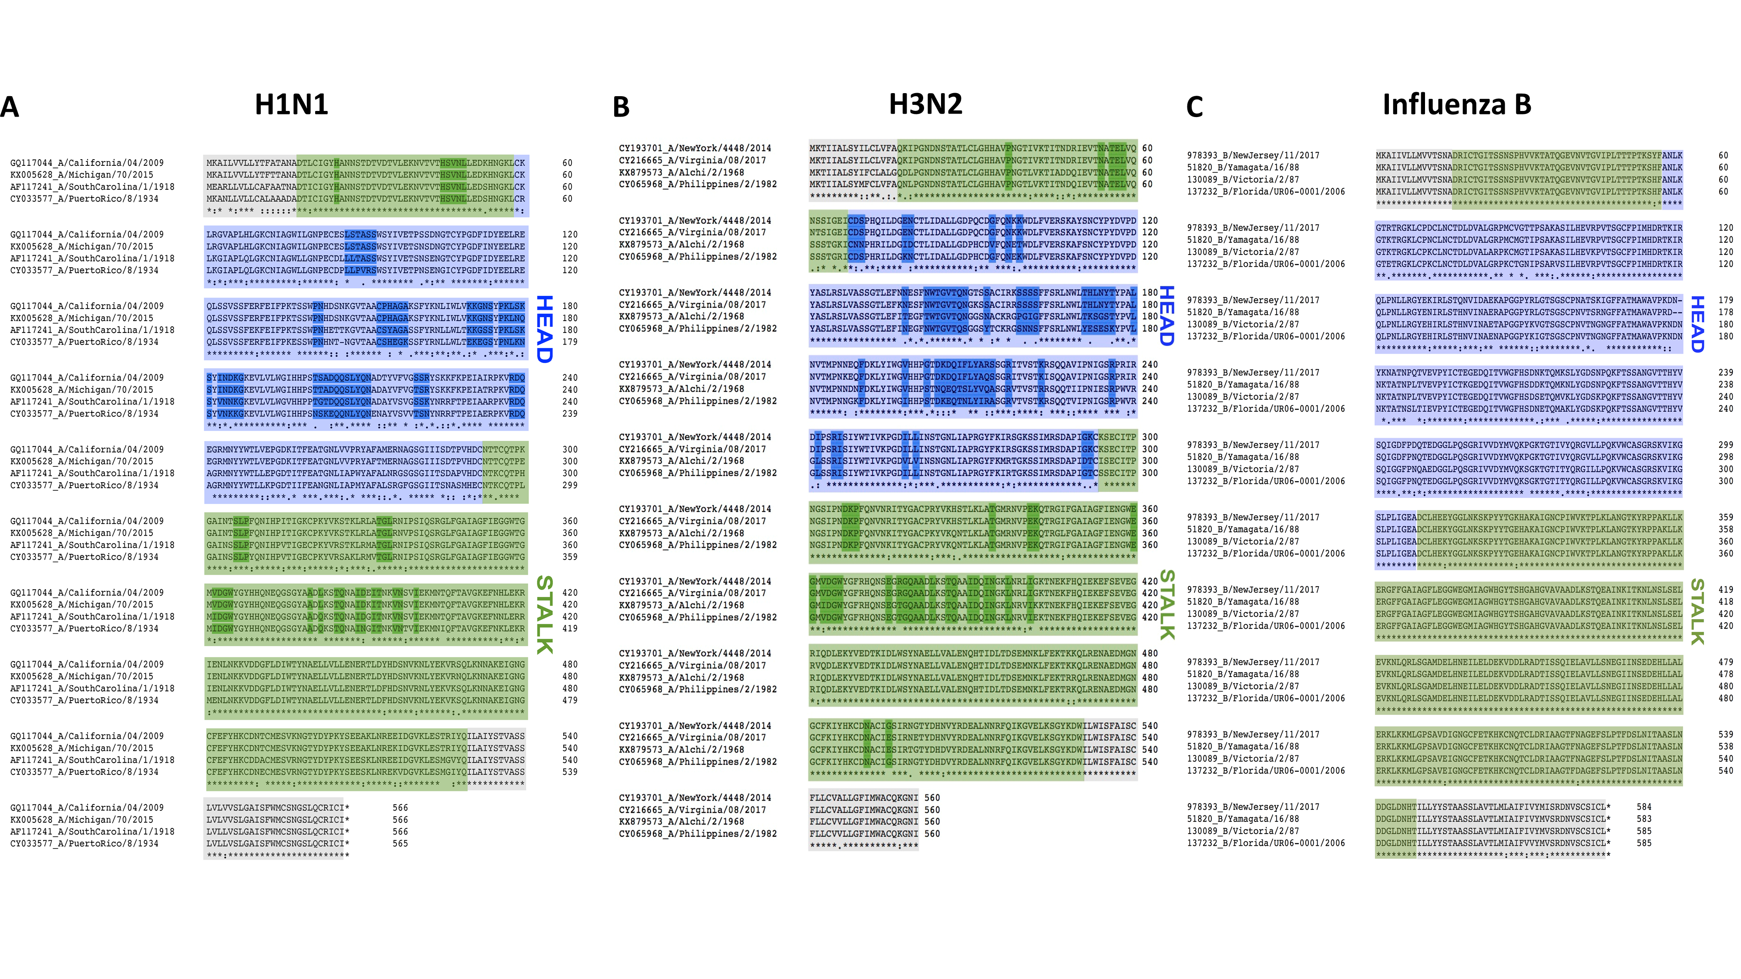
Cb
Site C
Site E
Sa
Ca1
Sa
Site A
Site B
Ca1
Sb
Ca1
Ca2
Site D
Site B
Site D
Site D
Site C
Refs: Caton et al., Garcia-Barreno et al., Matsuzaki et al., and Manicassamy et al.
Refs: Underwood and Wiley et al.

Slide 2
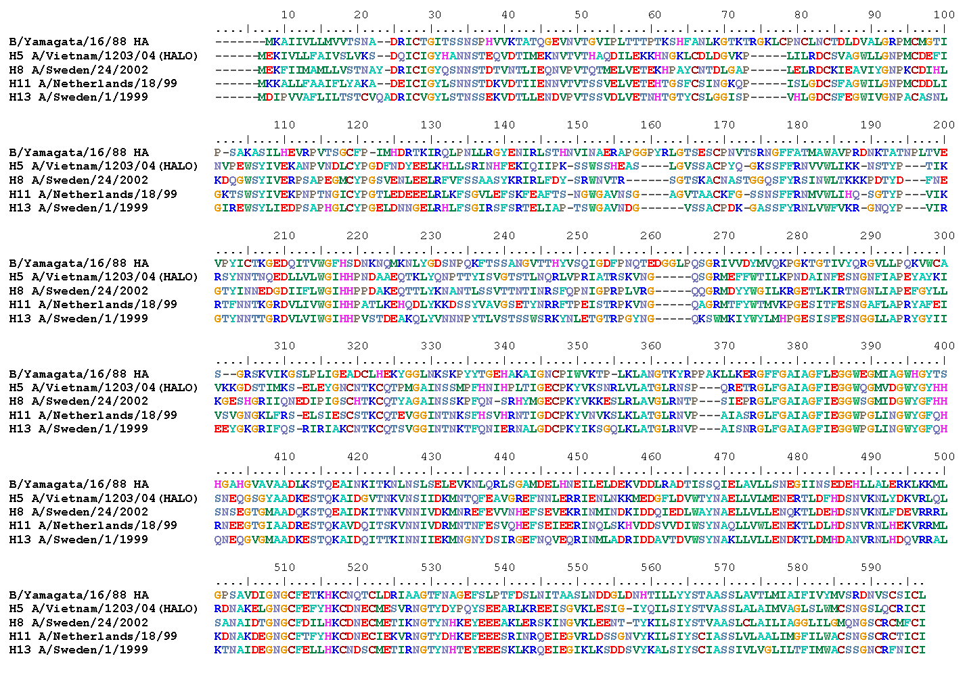
Alignment of influenza B virus HA with group 1 influenza A virus HAs
120 loop
150 loop
160 loop
190 helix
Provided by Dr. Weina Sun

